Slide 1
An Analysis Plan for EMS Station Location and Vehicle Allocation
SCC Fall 2023

Slide 2

Motivations & Research Questions
Current setup of Vance County EMS has led to North district residents being underserved
Coupled with rising demand for EMS services in the North, a new Northern station is being proposed with two potential locations
We want to answer the following two questions:
Which of the proposed North district station locations would better serve the community?
How should the 4 available ambulances be allocated to best serve the community?

Slide 3
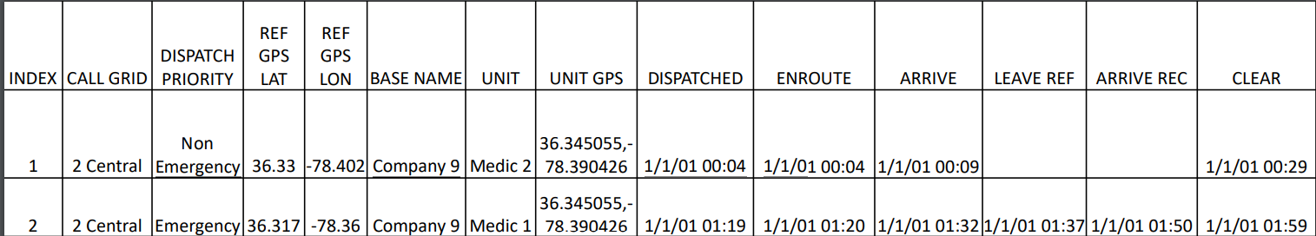
The Data
The data originates from written charts made by EMS provider.
The dates of each trip have been manipulated into a mock dataset to protect patients’ privacy.
Each row represents a single trip with details such as the dispatch station, the coordinates of the patient's address, various logged times (dispatch, enroute, arrival to site, leaving site, arriving at hospital, and clear time), and other details about the trip.
We can use this information to analyze travel times, the associated system load, and assess different station location and vehicle allocation scenarios.

Slide 4
Scenarios Overview
The data has 5 reasonable scenarios to perform our analysis on. We have 4 total ambulances with 4 different stations- Near North, Far North, Central, and South.
Scenarios | S0 (Current) | S1 | S2 | S3 | S4
Far North | 0 | 0 | 1 | 0 | 1
Near North | 0 | 1 | 0 | 1 | 0
Central | 3 | 3 | 3 | 2 | 2
South | 1 | 0 | 0 | 1 | 1

Slide 5
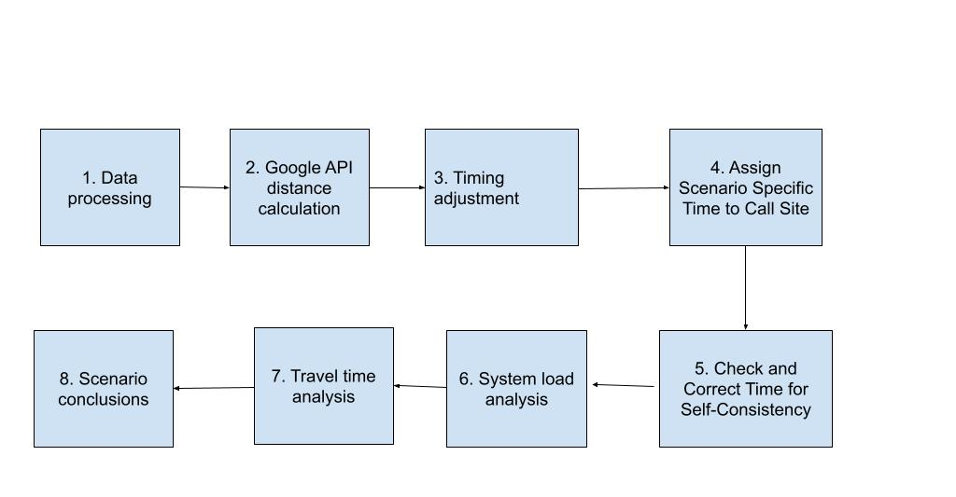
Proposed Analysis Pipeline
Notes:
Data Processing
Google API to generate new features on travel time
Best case, green light, average case, worst case
Timing adjustment
Assigning Specific Scenario Times to each Call
Checking and Correcting Time for Self-Consistency
Perform system load analysis with binary indicator
Perform travel time analysis on dependency of travel times on scenarios
Reporting Conclusions/Findings

Slide 6
Data Preparation
Data Quality Check:
Decide whether to include data with atypical features
Example: calls outside Vance County Boundaries
Determine how frequently expected dispatch rules are followed
Example: all calls are addressed by an ambulance from nearest station, if there is an ambulance available
Recommended Initial Analysis of Temporal and Spatial Patterns:
Average distance and travel time from a call to each station
Call volume for each region (North, Central, and South)
For each region, call volume and average travel time by:
Hour of the day
Day of the week
Month of the year

Slide 7
Google Distance Matrix API Background
Simple implementation of Google package for calculating distance estimates
Takes multiple origin and destination locations
Returns a matrix of expected travel times and distances
Travel time estimations can be adjusted with parameter manipulation
Parameter options include:
Traffic Model Specifics – Optimistic, Pessimistic, Best Guess, Green light
Outputs will be adjusted based on a ‘duration in traffic’ estimate depending on the traffic input parameter to adjust expectations to more accurate real-life scenarios
Expected durations for trips can only be projected on future dates. This could cause potential distortions to trip estimates and introduce confounders
To reference the documentation for the Google Distance Matrix API click here

Slide 8
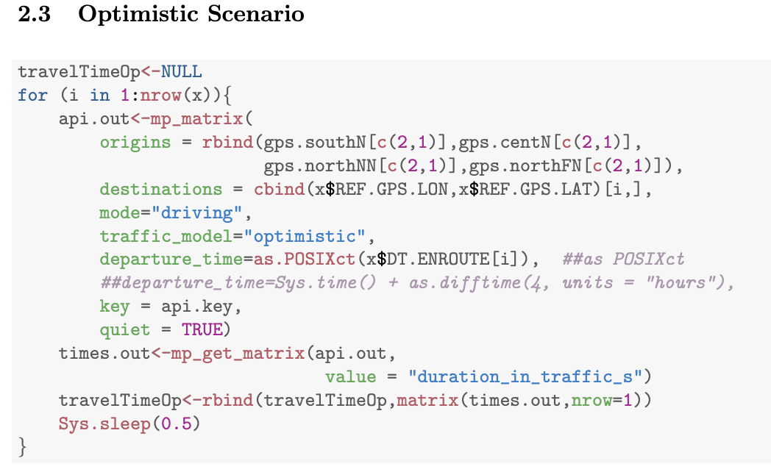

API Bandwidth Limitation
Limited bandwidth available when making calls/requests to API
Full analysis requires numerous individual requests separated by brief time delays
Example: “Sys.sleep(0.5)”
Introduces brief pause at end of each iteration of for-loop
Used in Best Guess, Pessimistic, Optimistic, Green Light scenarios
Pause provides API sufficient processing time
Run code overnight
for-loop

Slide 9
recommendations

Slide 10
recommendations

Slide 11
Analyzing API Estimate Accuracy as an Optional Step:
Multiple Linear Regression Models & Bayesian Additive Regression Trees (BART) Model
Objective: Evaluate and adjust Google API estimates for travel times from station to site.
Predictor Variables: Various API-estimated travel times (GL, Pe, BG, Op), time of day (segmented into Morning, Afternoon, Night), and distance traveled.
Analysis Framework:
Load data & create / organize predictor variables of interest.
Split data into testing & training sets.
Build a multiple regression model (on training data) using the predictors above, and one with just the best guess estimate. Do the same process for the BART model.
Compare predictions (on test data) using Root-Mean-Squared-Error (RMSE) calculations.
Determine if adjustments to API estimates are necessary based on model fit / performance.

Slide 12

Simple / Multiple Linear Regression Model:
Bayesian Additive Regression Trees (BART) Model:
The BART model, a tree-based method, utilizes Bayesian decision tree frameworks to help capture nuanced, non-linear patterns in data, which can be helpful with travel time deviations and other factors that could affect your API estimates.

Slide 13

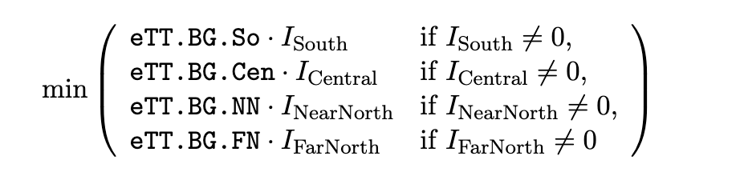
Combining API Regression Model with Scenario Specifics
For each observation/call, calculate the output travel times from each station (i.e. eTT.BG.So, eTT.BG.Ce, eTT.BG.NN, and eTT.BG.FN if you had chosen the Google API’s Best-Guess model)
For example: REF.GPS.LAT of 36.4240 and REF.GPS.LON of -78.4538 (located at the Northern end of Vance County), for Scenario 1 (one ambulance at Near North and three ambulances at Central station), the ambulance departure location would be assigned to Near North.
The indicator variables (i.e. ) are indicating whether there is an ambulance located in that station for a specific scenario.
Should you opt into the API-to-travel-time adjustment model, an additional step is as follows:
For each call / observation, implement it as the input to the the API-to-travel-time adjustment model of your choosing, and use output times as the resulting response time to the test data

Slide 14
Specific Scenarios to Address
PURPOSE: It is important to add a corrective step to account for overlapping trips. You need to identify the times when the dispatch occurs, and the closest vehicle is unavailable to respond.
STEPS:
END_TRIP = (DISPATCH_TIME - ENROUTE_TIME)+DISPATCH_TIME + ESTIMATED_TT + (ARRIVAL_TIME - AVAILABLE_TIME)
If END_TRIP is negative, then it indicates that each of the ambulances are on a trip, and the response time is effected.

Slide 15
Load Analysis
Purpose: Examine how the different scenarios would increase or decrease stress on Vance County’s EMS System
Method: Use a binary indicator Y to represent whether the ambulance at the closest station is available
Y = 0: Indicates the closest ambulance was not available
Y = 1: Indicates the closest ambulance was available

Slide 16
Model 1
Purpose: Calculates the probability of whether a call’s closest station varies between the different scenarios
Steps:
Create a 0-1 binary indicator (dummy) variable for the event that load is not sensitive to scenario
Create a logistic regression model to identify time- or location-related variables that are associated with the dummy variable

Slide 17
Model 2
Purpose: Using only the calls that are predicted to vary across scenarios, this model will calculate the dependence of the load metric on scenario (i.e. how the load metric varies between different scenarios) by measuring the number of calls where the ambulance at the closest station was available for each scenario
Steps:
Create a logistic link Generalized Linear Mixed Model that includes a random effect for call ID and a fixed effect for scenario
Compare the different scenarios’ numbers to determine which scenario has the greatest number of closest station ambulance dispatches, and which has the least

Slide 18
Understanding Travel Time Variations
Purpose: discover whether the estimated travel times exhibit variation across different scenarios
Method: formulate a binary outcome, where “1” indicates a variation in travel time across scenarios and “0” signifies no variation, and then employ a logistic regression model, considering the binary nature of the outcome

Slide 19
Logistic Regression Model
Model: variable differ is the binary outcome and covariates include factors such as season, hour of the day, day of the week, priority, system load
The response variable is the binary outcome “differ,” and the predictor variables, or covariates, encompass factors such as season, hour of the day, day of the week, priority, and system load.
Interpretation: this model will allow us to calculate the probability of observing a variation in travel times across scenarios, given the covariates
Regarding the model’s interpretation, since the primary focus is on the impact of ambulance distribution on travel time, the baseline scenario should be identified and the offset term for each scenario should be examined in the model output. The scenario presenting the smallest or most negative offset term corresponds to the shortest travel time predicted by this linear mixed-effect model and would be the scenario of interest.

Slide 20
Modeling Travel Time with LMM
Purpose: given travel times exhibit discernible variation across scenarios, we further model out how these times are dependent on the respective scenarios
Method: our tool of choice is the Linear Mixed Model (LMM) implemented using the lme4::lmer() function in R

Slide 21
Modeling Travel Time with LMM (cont.)
Model: include the response variable travel time (tt), a fixed effect (scenario), a random effect ((1 | eventID)), and additional covariates, such as time of day, season, system load
Interpretation: LMM allows us to comprehensively consider both fixed and random effects, offering a holistic perspective on travel time dynamics

